Slide 1
12, 13- Exercise

Slide 2
Fizz buzz algorithm
depending on the input we give it, it returns different results.
Here are the rules:
If the input that we give it is divisible by three, it will return the string Fizz.
If the input is divisible by five, it will return Buzz.
if the input is divisible by both three and five, it will return FizzBuzz.
For any other numbers it will return the same input

Slide 3


Slide 4
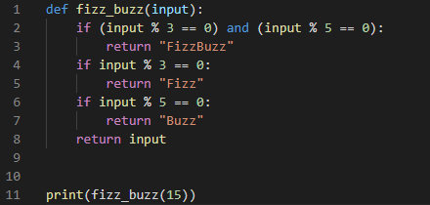
when you have an if statement and in your if block your returning a value you don't really need an else clause, Because if this condition is evaluated to false, the control moves to the else clause and all we're doing here is returning a different value. So this is the only possible outcome

